Slide 1
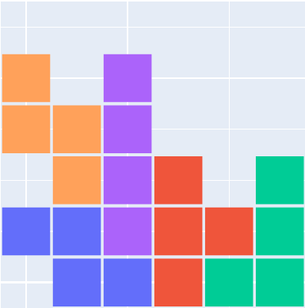
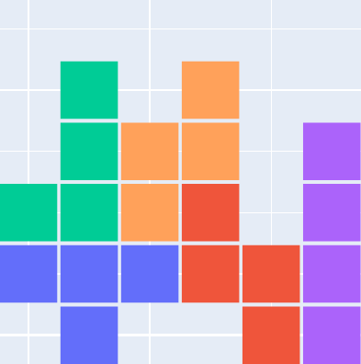
[S,T,L,I,Z]
CX Op
[T,Z,L,I,S]
Parent
Offspring
[0,1,2,4,1]
[0,1,2,4,1]
No change

